Slide 2
Project Title
Real-Time Log Visualization using DevOps
Project Guide
Mr. Harvinder Singh
Assistant Professor,
School of Computer Science

Slide 3
Team Members & Role
Mr. Ekanshu Dargan : Literature Review, Documentation, Implementation and Coding
Mr. Babanjot Singh : Literature Review, Documentation, Designing and Coding
Mr. Manik Khurana : Literature Review, Documentation, Coding, Integration and Testing
Ms. Chhavi Sharma : Literature Review, Documentation, Coding, Analysis and Testing

Slide 4
Introduction
This project serves as an application - a future solution - to a time-costly problem of getting logs manually generated with the help of the outdated applications.
Using our solution the developers will be able to save a lot of time and they can then focus on more important modules and grow at a greater rate.
The solution is an ansible playbook that performs the functions of setting up Elastic stash through which we will perform all the tasks.
There are various Devops tools through which we will create an interface from taking the logs and processing it , applying sorting on it , getting specific or desired outputs as per our requirements. Following are the tools that we will use

Slide 5
Literature Review
F.M.A. Erich, C. Amrit & M. Daneva, University of Amsterdam [1], found main goals to achieve by implementing DevOps: Reduce lead-time, improve problem solving and improve feedback. Starting new projects took a very long time at the organization, as teams had problems obtaining development resources such as servers and software.
Pavel Masek, Martin Stusek, Jan Krejci, Krystof Zeman, Jiri Pokorny, and Marek Kudlacek Department of Telecommunications, Brno University of Technology, Brno, Czech Republic [2] in this paper, considered building up a new layer for the utilized Ansible orchestration tool.
Michael Jade Mitra, School of Computing and Information Technologies Asia Pacific College Makati, David Paulo Sy School of Computing and Information Technologies Asia Pacific College Makati, Philippines [3] presented the real-world usability and best practice compliance of ELK Stack and how ELK was able to convert big companies to use their stack.

Slide 6
Problem Statement
Through log analytics we can collect and analyze the data that is generated by resources.
As the log data grows the operations team starts facing issues to consolidate and manage the large data of log files.
The issue with log data is that the logs are unstructured that are generated from various layers produce different types of logs.
The challenge lies in consolidating the log data, process it to generate the Business and technical insights.

Slide 7
Motivation
Inspired by the stale state of security, the developers have been trying and failing to securely conclude researches with constructive results
Most of their attempts were not grounded regarding the codes and the data they shared.
That’s why there was a need to introduce an effective system of solving what we see is a great solution to reducing time by a lot many folds

Slide 8
Objectives
The primary objective of the project is to analyze and visualize log data in real-time. ELK helps achieve this goal. It will provide a centralized logging that will be useful when attempting to identify problems with the servers or applications and solve them. The whole process is automated and can be done with a single click thereby saving a lot of workload and downtime every time an error is encountered.

Slide 9
Software/ Hardware Requirement
Hardware:
Intel(R) Core(TM) i3-3200 CPU @ 1.5 GHz
2 GB RAM
System type is 32/64-bit Operating System
Software:
Linux based OS
Ansible

Slide 10
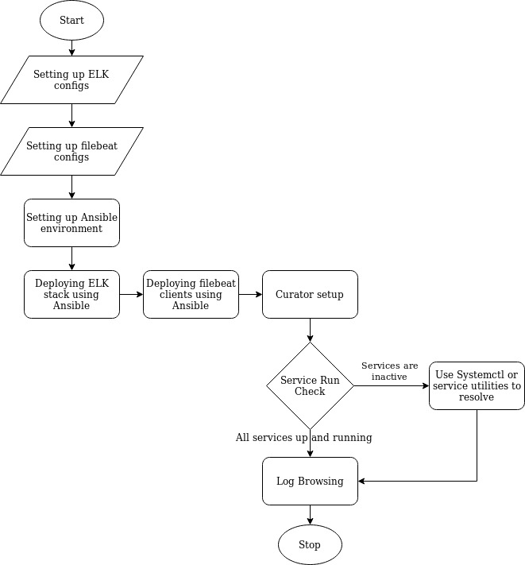
Flowchart of the System

Slide 11
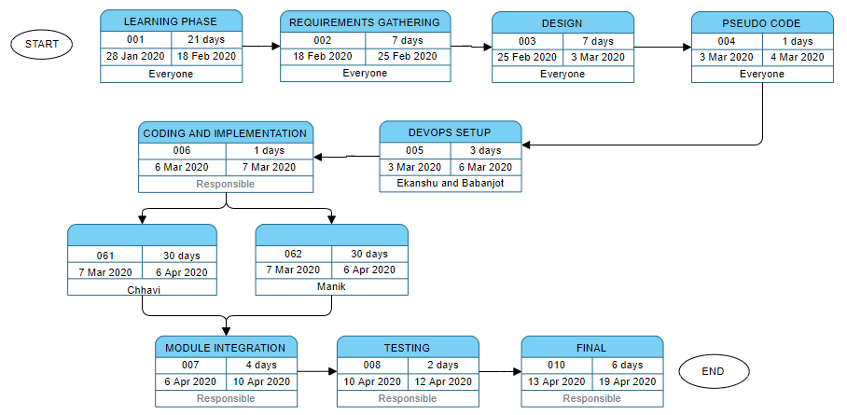
PERT Chart

Slide 12
References
[a].https://docs.ansible.com/
[b].https://www.elastic.co/guide
[c].https://jenkins.io/doc/
[d].https://docs.docker.com
[e].https://docs.aws.amazon.com
[f]. https://guides.github.com

